Slide 1
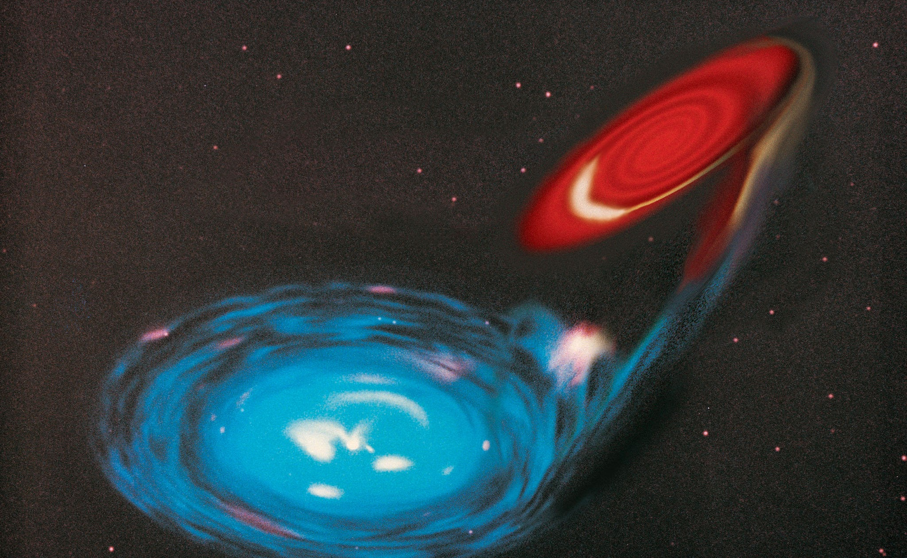
How to query datasets

Slide 2
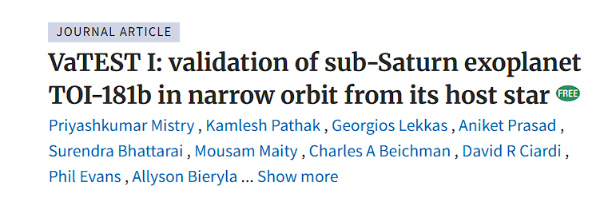
Positioning of the object
Right Ascension and Declination : Sky coordinates
Galactic latitude and longitude: Another Sky coordinates
Nomenclature of Objects
Different telescope surveys catalogue the objects with numbers
Pulsars: PSR J0034-0721, Exoplanets: TOI 181b K 223b, Galaxies: NGC 2024, M 87

Slide 3
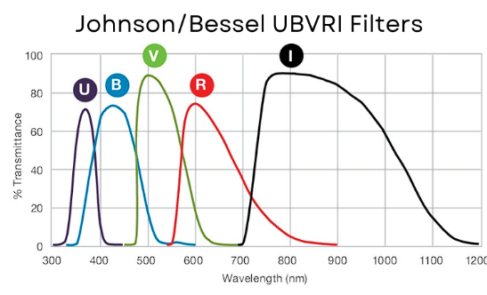
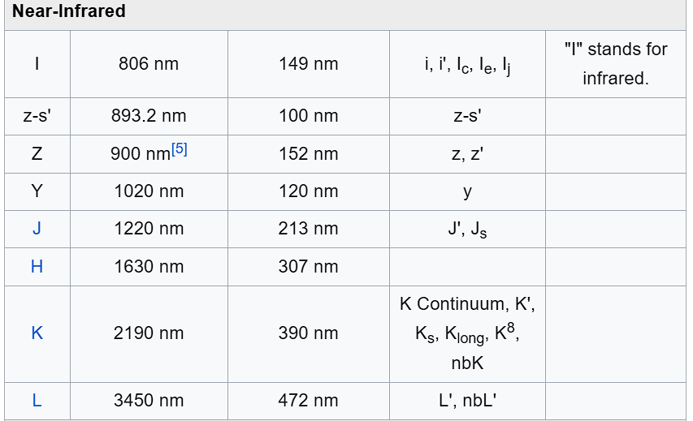
Filter

Slide 4
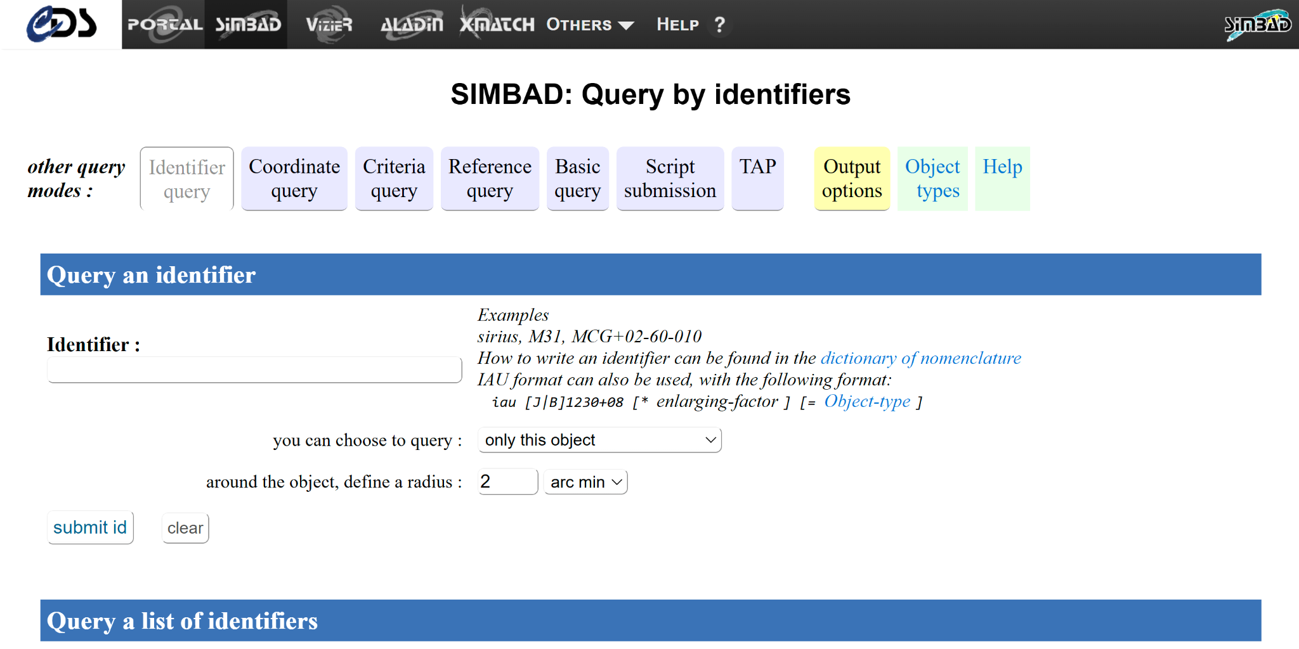
SIMBAD: To know the name

Slide 5
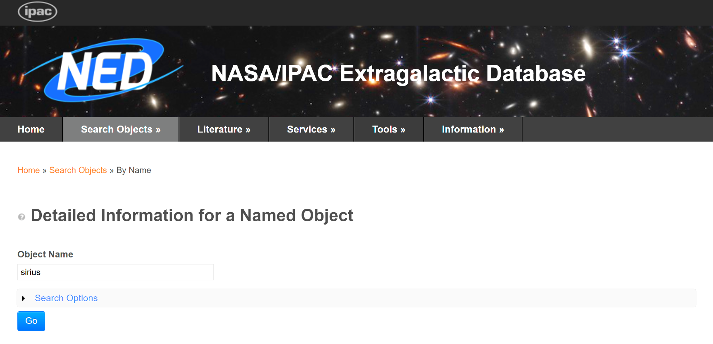
NED: To know the names

Slide 6
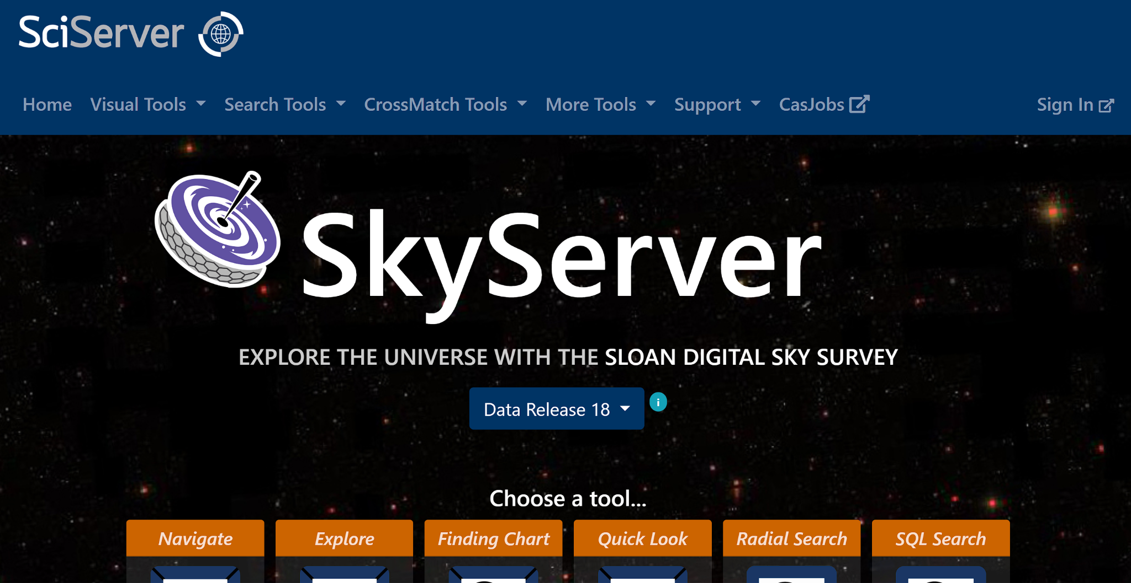
Skyserver
https://www.sdss.org/dr18/tutorials/
Used for SDSS FITS files
Can download image and spectra

Slide 7
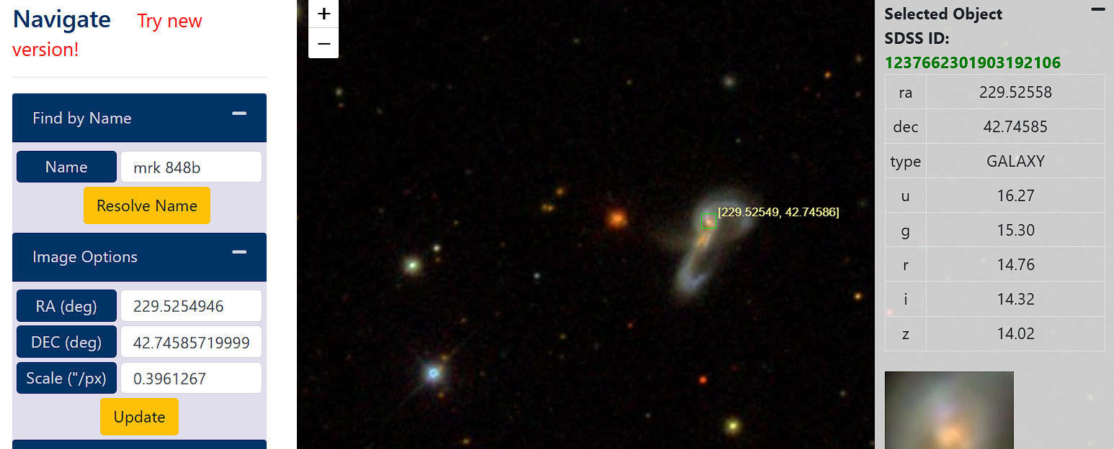
SDSS J151806.13+424445.0 which is Mrk 848

Slide 8
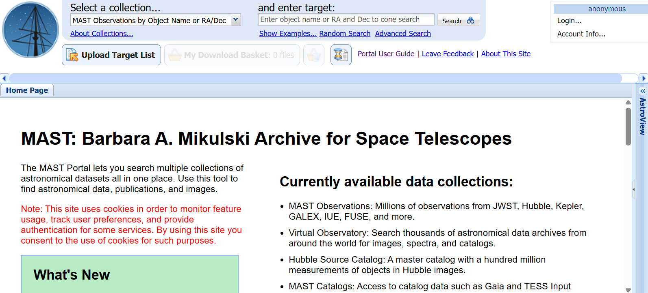
MAST: JWST/Exoplanet Data download
https://mast.stsci.edu/portal/Mashup/Clients/Mast/Portal.html

Slide 9
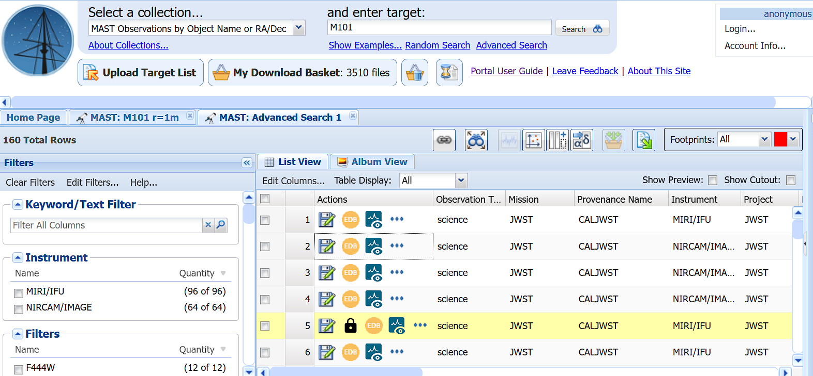
For viewing online

Slide 10
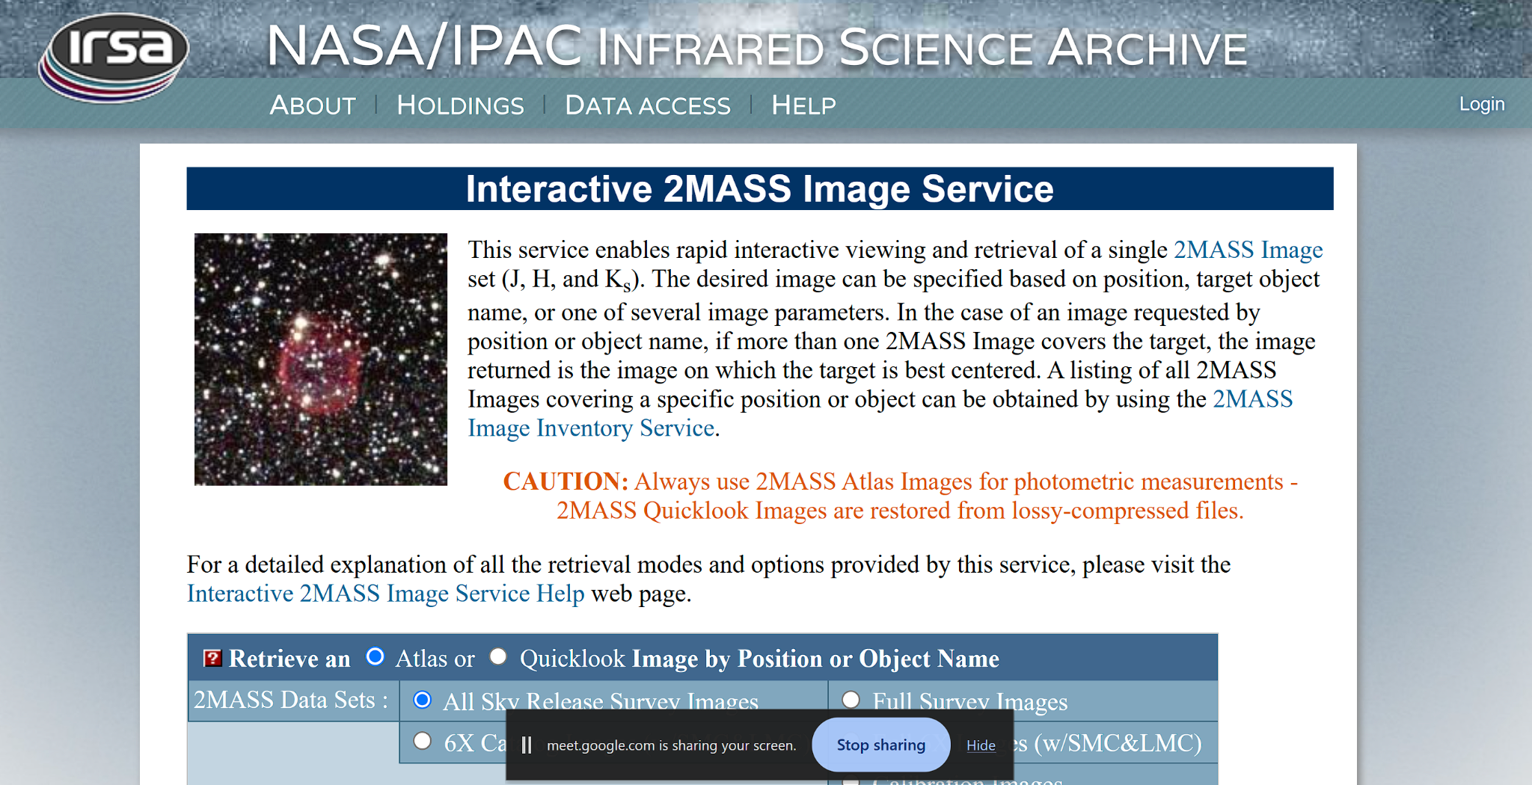
For you to explore images: 2MASS
https://irsa.ipac.caltech.edu/applications/2MASS/IM/interactive.html

Slide 11
Try to make RGB images:
Check the images in this site:
https://www.ipac.caltech.edu/2mass/gallery/images_ysos.html
Search the object in 2MASS database (For ex: T Tauri) for Atlas images
Download the 3 filter data it has options of.
Try to make RGB imaging with proper scaling (can use python or DS9)
The Image you might be getting is also shown in the link above. Make your own RGB and Compare !!!!

